Slide 1
ClimbCode
Notes:
Welcome to ClimbCode’s exposition. Here we’ll see the main features of this project.

Slide 2

Our Path Today
The Workgroup
Idea & MVP
Business and costs
Work Methodology
2
Notes:
The main points we’re going to talk about are the following ones: First, we’ll introduce the team which will develop the project. Next, we’ll talk about the idea that ClimCode represents and which are the features that form the Minimum Viable Product. Then, we’ll skip to the business environment and the costs of the project, followed by the ways that we will have in order to achieve profit with it. Finally, we’ll speak about the work methodology that will be followed in the development of the project, and the technologies that we will use on it.

Slide 3
The Workgroup
Notes:
First, let’s introduce our team members.

Slide 4


The Workgroup
Alejandro Román Rodríguez
Project Manager
Álvaro Domínguez Núñez Business Manager
4
Notes:
Alejandro Román, who is the Project Manager, Álvaro Domínguez, the Business Manager…

Slide 5


The Workgroup
Andrés Fernández Alés
Software Engineer
Alejandro Garrido Resina
Software Engineer
5
Notes:
And the software Engineers: Andrés Fernández, Alejandro Garrido…

Slide 6


The Workgroup
Miguel Ángel Baños Carretón Software Engineer
Álvaro Sánchez López
Software Engineer
6
Notes:
Miguel Ángel Baños, Álvaro Sánchez…

Slide 7

The Workgroup
Jesús Sosa Sánchez
Software Engineer
7
Notes:
And Jesús Sosa. These are our seven members.

Slide 8
Idea & MVP
Notes:
Now we’ll talk about the main idea of ClimbCode, and its principal features.

Slide 9

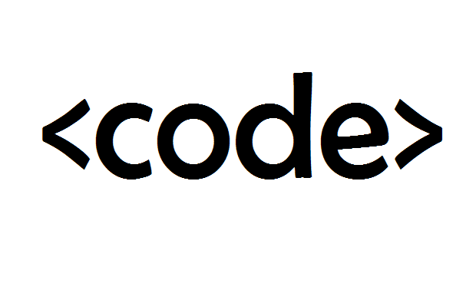
Idea & MVP
+
=
ClimbCode
9
Notes:
ClimbCode is the result of a fusion between teaching and programming. This fusion is, in fact, a plataform used to support the teaching of different subjects at schools and academies. This support is given as interactive exercises which use programming in order to teach other concepts from other different subjects.

Slide 10


Idea & MVP
=
+
Interactive
10
Notes:
This exercise are nothing but a combination of the usual exercises and coding, which results into a new brand kind of exercises which form the principal content of our platform. These exercises are an alternative to the usual ones instead of a way to learn programming, fulfilling the objectives of the usual ones in a new and interesting way.

Slide 11

Learn Programming?
11
Notes:
But the fact of using programming to create those exercises makes a great doubt appear: Is it necessary to learn programming to use this plataform?

Slide 12

Learn Programming?
12
Notes:
The answer is absolutely not! And that’s because the exercises, despite being created by those means, are interactive and both teachers and students can make use of them without any programming knowledge.

Slide 13
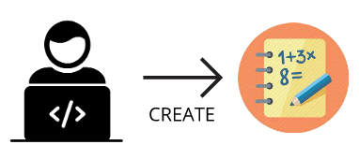
Idea & MVP
Interactive
13
Notes:
Then, where do those exercises come from? It’s simple. Independent programmers create them in our platform. Those exercises are tested before allowing them to be added to the main list of content, in order to know if they suit the platform’s point of view before the users can use them.

Slide 14

Idea & MVP
Interactive
14
Notes:
That’s when the schools and academies come to scene. They buy those exercises from the programmer in order to increase the amount of exercises they have and offer their teachers a higher volume of content to use in their lessons.

Slide 15

Idea & MVP
Interactive
15
Notes:
In order to make these purchases, schools and academies can view a list with every single exercise that is in the system, choosing the ones they want to get and paying the price associated to the exercise.

Slide 16

Idea & MVP
Student & Teacher:
Interactive
16
Notes:
Once the school acquires the new exercises, teachers can use then to support their lessons, and students can access them in order to do them and use them as an addition to their learning. Also, teachers will be able to upload and download documents related to their subjects into the platform, and students can also access it.

Slide 17

Idea & MVP
Administrator:
17
Notes:
And last, but not least, the administrators of the system will be able to register new schools, so as they can manage their teachers and students. Also, administrators will promote the exercises that the programmers ask them to, previously paying for it.

Slide 18
Let’s have a look
18
Notes:
To see which would be the main processes of the system, we’ve created an amount of mockups.

Slide 19
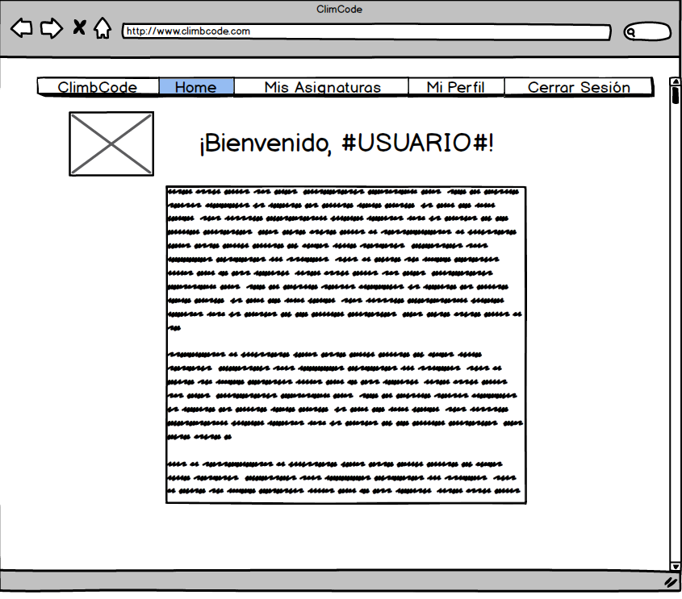
19
Notes:
In this one, we can see the view a student would have once he/she logs into the system. To do an exercise, the student just needs to access to the “Mis asignaturas/My subjects” view.

Slide 20
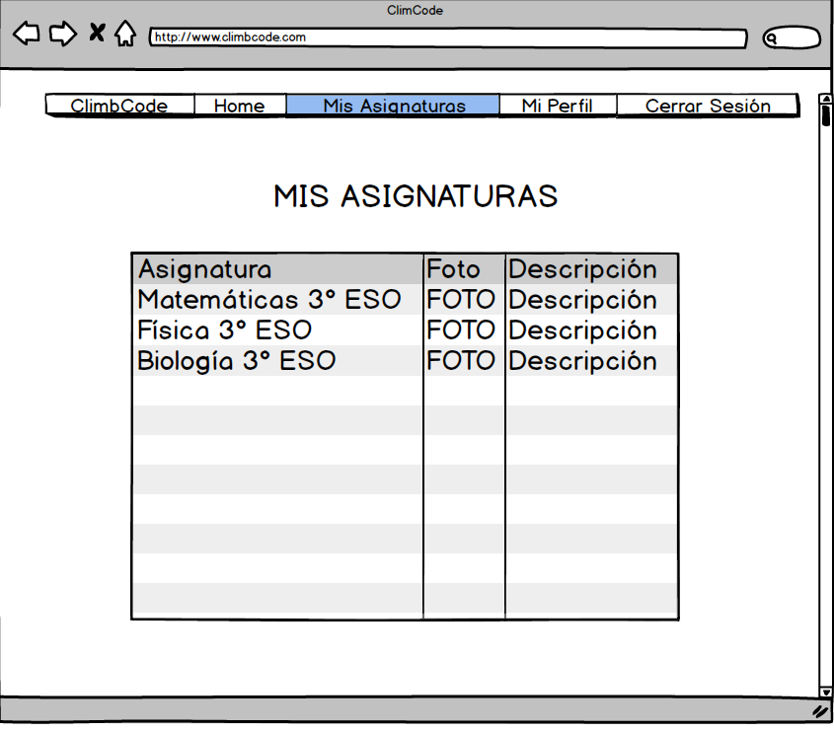
20
Notes:
Then, he/she would see the subjects he/she takes, and choose the one he/she wants to access by selecting its name.

Slide 21
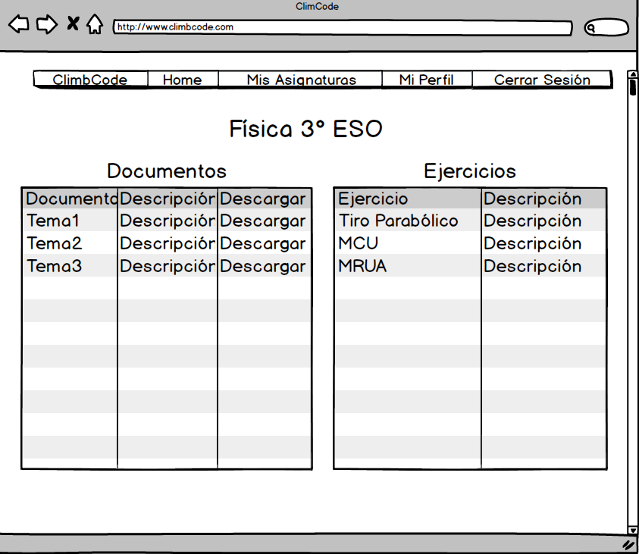
21
Notes:
That will lead the student to the content of the subject, which shows the documents he/she can download, and the exercises that has the subject. To do one, the student just needs to select its name.

Slide 22
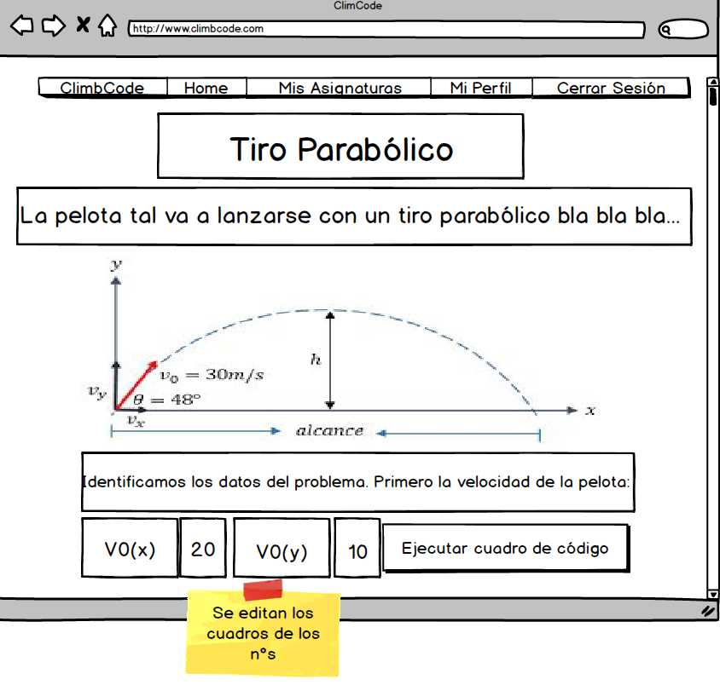
22
Notes:
That will show him/her the content of the exercises, which has a title, an introduction to the exercise with the data needed in it, a drawing of the result of the exercise, and explanations of how is it done, step by step, if it isn’t already done. Then, the student just needs to change the allowed sections to see the result of the exercise. In this case, those sections are the initial speed of the ball. After preparing the data, the student can see the result of his/her job by selecting the execution button. Also, there may be a button which would allow the student to see the code that lies below the exercise and understand its logic associated.

Slide 23
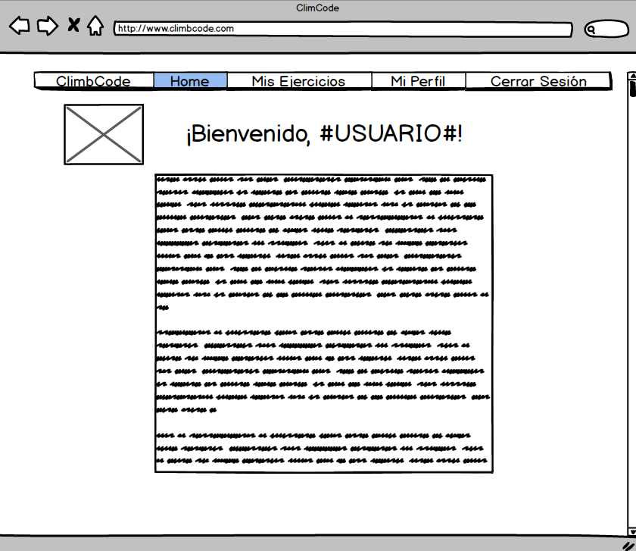
23
Notes:
The next mockup shows us what a programmer would see once he/she logs into the system. To create an exercise, he would acces the “Mis Ejercicios/My Exercises” section.

Slide 24
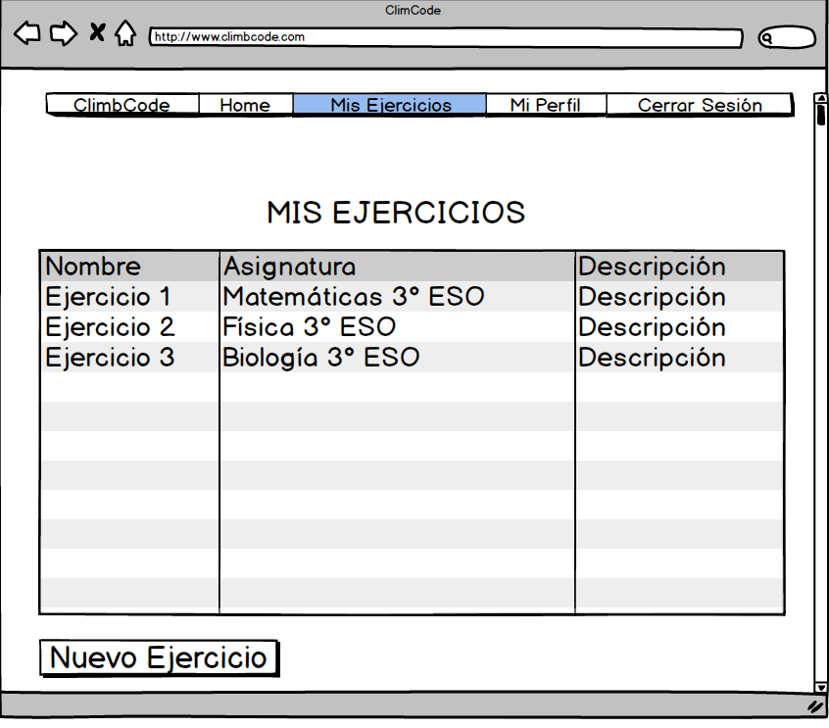
24
Notes:
Inside that view, we can see a list of all the exercises made by the programmer, followed by some of their features. To create a new exercise, the programmer just has to select the “Nuevo Ejercicio/New Exercise” button.

Slide 25
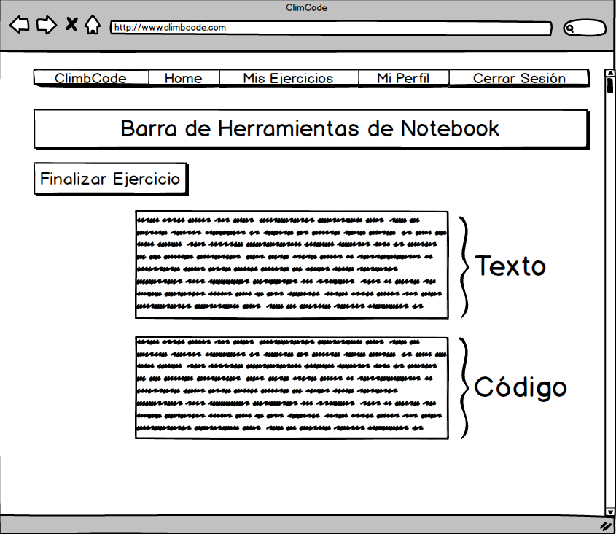
25
Notes:
That would lead him/her to a new view in which he/she can create his/her new exercise using the tools the platform has, which are the same a Notebook would have. Once the exercise is finished, the programmer can confirm its creation by the “Finalizar Ejercicio/Finish Exercise” button, which would put it awaiting its review and addition to the main list of exercises of the system.

Slide 26





Idea & MVP
26
Notes:
Now that we’ve seen how the platform will work, the next thing that comes to out mind is if this idea isn’t already developed. To answer this, we’ve studied many of our competitors, and the result of it is always the same: They’re focused in academic management, document managment, teaching programming or doing simple exercises not related to support anything with programming. That makes us a different choice, because we combine document management and supporting teachings with programming, fulfilling our competitors’ features and adding a new one with those interactive exercises.

Slide 27
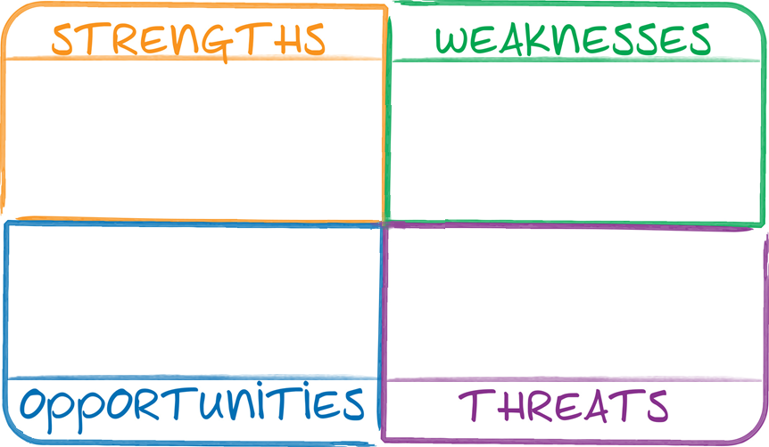


Idea & MVP
27
Notes:
Talking about our project’s strengths, we have that it is a different one, basing on the things we’ve said in the last picture, and that the platform is easy to use, because no programming knowledge is needed to do so.

Slide 28


Idea & MVP
28
Notes:
About or weaknesses, we find that it would be hard to expand to other markets, because our product is too focused on the educational sector. Also, if teachers have a too strict way to teach their lessons, it would be hard to introduce our product in their environment.

Slide 29

Idea & MVP
29
Notes:
Speaking about the opportunities, we have that it would be possible to jump to another platform different from the computers, for example tablets, which would increase the amount of clients we could get regarding the extension of the usage of tablets in teachers. The other opportunity is that it is also possible to add new features to our product, which would make us fulfill more of our client’s needs.

Slide 30

Idea & MVP
30
Notes:
And last, the theats that our project has to face are two: The fact that our competitors could take our idea and use it on their products, making competence harder for us, and the possibility that we can understimate the difficulty of developing some of our features, which could result into a delay in its development.

Slide 31
Business and Costs

Slide 32
Is it worth it?
32
Notes:
In order to know if the project would be accepted by our clients or not, we made a survey.

Slide 33
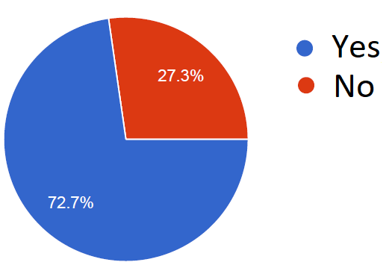
Business and Costs
From 88 people: Related to teaching
33
Notes:
In this survey participated 88 people, from which the 70% were related to teaching.

Slide 34
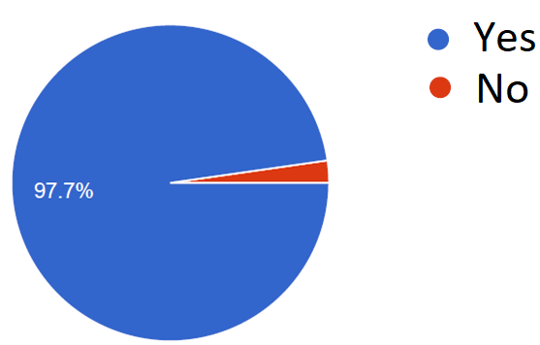
Business and Costs
From 88 people: Thoughts about programming
34
Notes:
They were asked if they thought that it was necessary to introduce students to programming regarding the demand of computer technicians in the business sector these days. Almost everyone answered they thought so.

Slide 35
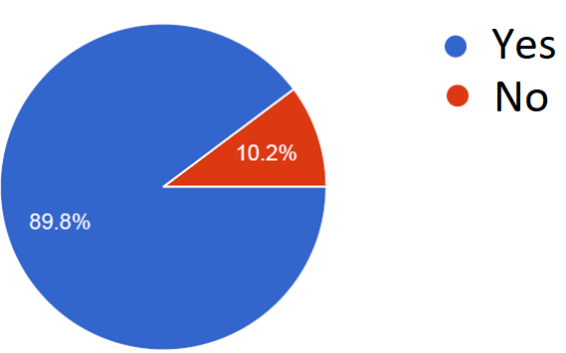
Business and Costs
From 88 people: Want a tool for programming at school
35
Notes:
Then they were asked if they would like to have a supporting tool to achieve that in schools. Again most of the people answered positively.

Slide 36
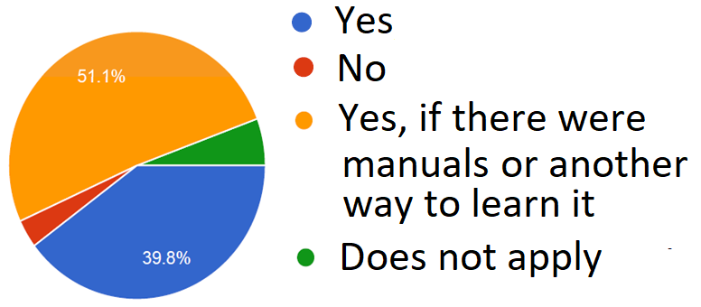
Business and Costs
From 88 people: Would use the tool
36
Notes:
Now entering in the usage of the tool, many of then answered again that they would use the tool, but in case that it was too complex, they would prefer doing so with the help of manuals or other helping tools. As we know, that wouldn’t be necessary at first, if we look at how our platform works.

Slide 37
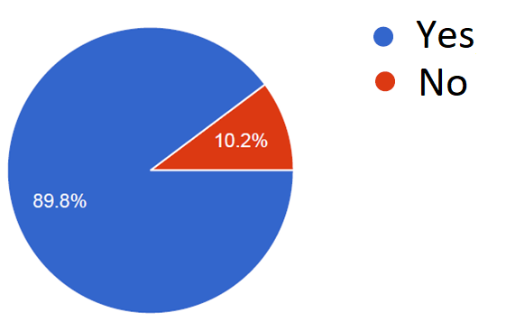
Business and Costs
From 88 people: Thoughts about students
37
Notes:
Finally, they were asked if they thought that students would see the lessons a bit more amusing with this tool, and they answered again that they agreed with that in most of the cases.

Slide 38

How much?
38
Notes:
Once we’ve seen the acceptance of our product, the next doubt that we can have in mind is how much would that project cost in practice.

Slide 39
Business and Costs
Direct Costs: 3700 €/m
Indirect Costs: 4750 €/m
Amortizations: 800 €/m
39
Notes:
Then, we can see that, in the 4 months that the project would develop, we have an amount of 3700€ per month in direct costs, which refer to our team’s salaries.
In the case of the indirect costs, we would have 4750€ per month spent into co-working spaces and hosting of the application.
Finally, about the amortizations of our team’s equipment, we would spent 800€ per month

Slide 40
Business and Costs
9250 €/m
37000 € + 4000 € = 41000 €
40
Notes:
All those costs would make a total of 9250€ per month, which lead to a total of 37000€ for the full development of the project. Adding the 4000€ saved for risks by the team, the project would cost a total of 41000€.

Slide 41
Business and Costs
41

Slide 42
Business and Costs
42

Slide 43
Is it profitable?
43
Notes:
But the fact of using programming to create those exercises makes a great doubt appear: Is it necessary to learn programming to use this plataform?

Slide 44


Business and Costs
Schools buy licenses
44
Notes:
The first way to do so would be selling licenses to schools. These licenses would be active for a year and would allow the schools and academies to make use of the full platform for an entire academic year, renewing it each one to keep the services. Also with the license, schools and academies would have access to an amount of starting exercises.

Slide 45
And tables to compare data
SIZE | USERS | FREE EXERCISES | PRICE
BASIC | 60 | 20 | 200€/y
MEDIUM | 200 | 50 | 550€/y
LARGE | 500 | 75 | 700€/y
45
Notes:
Then, we can order the different kinds of licenses we offer by the amount of users allowed to register and the number of starting exercises the client could access at first. That would lead us to these standard sizes of licenses, with their associated price. Also, in case of not finding a suitable size for him/her, the client can always contact us in order to negotiate an affordable size of license.

Slide 46
Business and Costs
Interactive
Schools buy exercises
46
Notes:
The second way we have for having a profit with these project is selling exercises. Interactive exercises have a buying price, which is payed for the schools and academies in order to increase the amount of exercises they have access to.

Slide 47

Business and Costs
ClimbCode
%
%
Programmer gets money
47
Notes:
From this price, a percentage goes to the programmer, acting as a motivation for possible content creators for the platform, and another percentage is kept for us.

Slide 48

Business and Costs
48
Notes:
As a clarification, all the previous transactions mentioned are made through PayPal, whose features will be integrated in our platform.

Slide 49
Work Methodology

Slide 50

Work Methodology
SCRUM: Three Sprints.
50
Notes:
As a working methodology, we would use the one told in the subject: SCRUM, using three sprints.

Slide 51
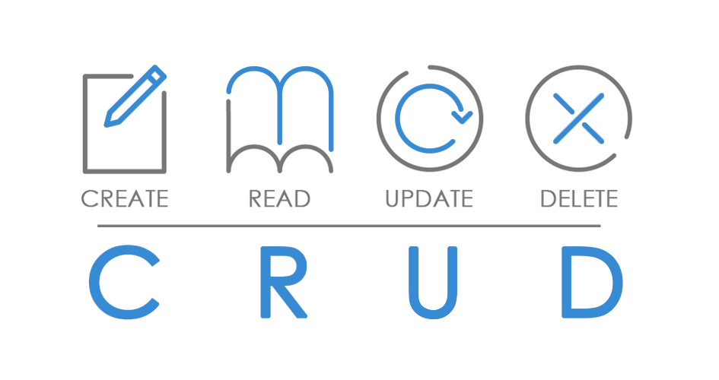
Work Methodology
Sprint 1:
Interactive
51
Notes:
In the first one we will focus on developing the main CRUD of the system, with the first iteration over the interactive exercises’ system, whose objective in this sprint will be creating and doing exercises, but not saving them. As a result, we would have a basic platform in which we can create and manage schools and subjects as an administrator, create users (teachers and students) and select the exercises we want in our license as a school, create exercises as a programmer, do exercises as a student, and have a group of initial interactive exercises ready to persist.

Slide 52
Work Methodology
Future Sprints:
Interactive
52
Notes:
So, the next sprints would be focused on saving the interactive exercises, promoting them, doing the document management section, managing the transactions in the platform, fixing the feedback we get, and developing filters and searching ways for the interactive exercises’ list

Slide 53



Work Methodology
Development:
53
Notes:
About the technologies we’re going to use, related to development we will use Pyhton, Django and PostgreSQL for the main part of the product, and Notebook and JavaScript for the interactive excercise management. These technologies are known for the development team, though it isn’t the one we are most familiar with.

Slide 54
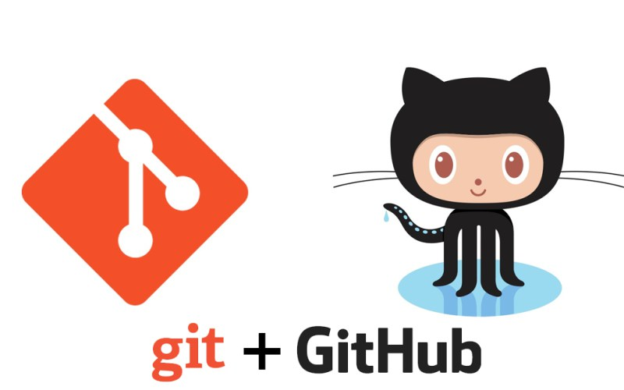
Work Methodology
Knowledge:
54
Notes:
Regarding the knowledge management, we will make use of a git repository hosted in github, where we can follow the development of the project and its tasks, adding the documentation and the knowledge generated if needed.

Slide 55

THANKS!
You can find me at
alvdomnun@alum.us.es
55
Notes:
And that’s the end of our presentation! Thank you for watching, and if you have any doubt you can contact me at alvdomnun@alum.us.es.

